Slide 1


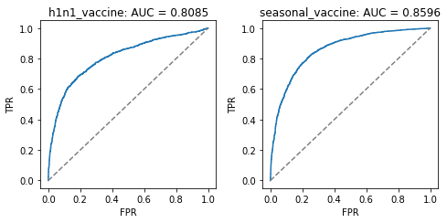
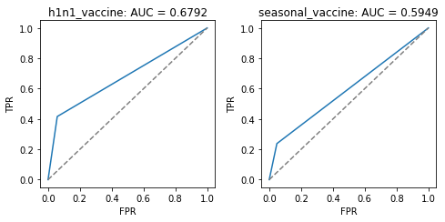
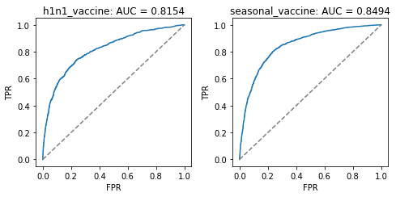
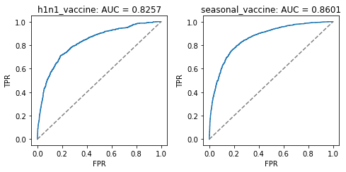
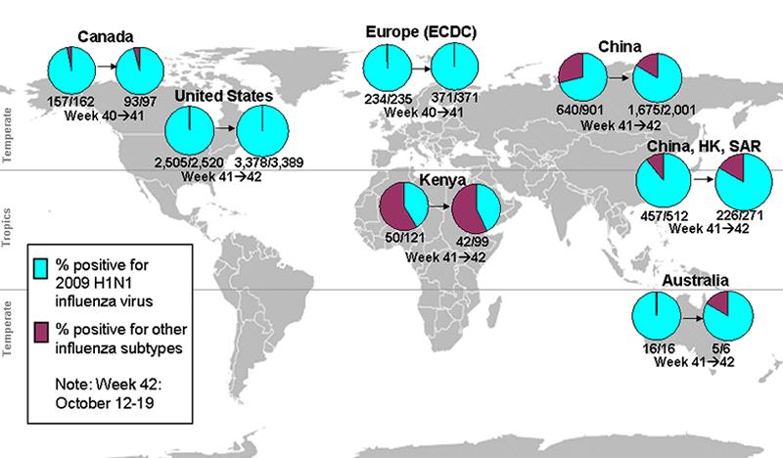
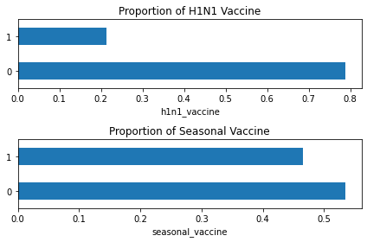

FLU SHOT LEARNING: PREDICT H1N1 AND SEASONAL FLU VACCINES
Srividya Inampudi, Greshma Johnson, Jay Jhaveri, Niranjan S. Mentor: - Dr. Kuldeep Chaurasia
Abstract
Evaluation of the results:
In our implementation, we have used the roc_auc_score() method from the sklearn.metrics library.
The roc_auc_socre function computes the area under the curve by this the curve information can be summarized in one number this is also denoted as AUC or AUROC.
The H1N1 Flu that came into existence in 2009 in the U.S. and spread to the rest of the world had a great impact on the lives of people around the world. It was a life-threatening season to hundreds of people which eventually made the World Health Organization (WHO) to declare it as the greatest pandemic in more than 40 years. As it continues to circulate worldwide vaccination should be carried out effectively. The vaccines for H1N1 were first publicly available in the United States in October 2009, when the US government began a vaccination campaign and people took vaccination. In this paper, we use the data from the National 2009 H1N1 Flu Survey (NHFS) to develop a model that predicts how likely people got H1N1 and seasonal flu vaccine.
SVM: RBF Kernel
Logistic Regression
Introduction
H1N1 or swine flu virus first emerged in the spring of 2009 in Mexico and then in the United States and quickly spread across the globe.
A unique combination of influenza genes was discovered in this novel H1N1 virus which was not identified prior in humans or animals[1].
This contagious novel virus had a very powerful impact on the whole world on June 11 2009 the World health Organization (WHO) declared that a pandemic of 2009 H1N1 flu or swine flu had begun.
According to CDC the first and foremost step in protecting oneself of this virus is a yearly flu vaccination. Various factors such as age, health status of an individual which affects the ability of the vaccination to provide protection to the person who is vaccinated.
Several activities were performed using various social media platforms and broadcasting networks such as Twitter to track the levels of disease activity and the concern of the public towards this pandemic situation[2].
Random Forest Regression
Artificial Neural Network
Best Results Obtained
Model | H1N1 Flu Score | Seasonal Flu Score
svm | 0.8085 | 0.8596
random_forest | 0.8154 | 0.8494
logistic_regression | 0.6792 | 0.5949
ANN | 0.8257 | 0.8601
Proposed Method
Proportion of people
who received
H1N1 vaccine and Seasonal Flu Vaccine
The main aim of our project is to find the probability that a person will receive H1N1 and seasonal Flu vaccination based on many parameters.
The data obtained from the National 2009 H1N1 Flu Survey (NHFS) contains 3 CSV files namely the training set features, the training set labels, and the test set features.
We have considered various methodologies and compared different Machine Learning and Artificial Neural Network models to predict the required probability.
The Machine Learning algorithms such as Linear regression, Support Vector Regression, Random Forest Regression, Logistic Regression, Ridge Regression, K Nearest Neighbors, and XGBoost were used.
Artificial Neural Network (ANN) with different optimizers such as Adam, RMSprop, SGD were used to predict the probability of the test set features.
Conclusions
Prediction of H1N1 and seasonal flu vaccination are based on the data source given by the Nation H1N1 flu survey 2009(NHFS) and center of disease control (CDC).
Prediction of H1N1 vaccination is done best by the SVM with RBF kernel using hyperparameter tuning and seasonal flu vaccination prediction is done best with Artificial neural networks.
Awareness was created in all kinds of social media in order to give the required information to the people regarding the importance of the H1N1 vaccine and seasonal flu vaccine in 2009.
Experimental Results and Discussion
References
Predicting the Results:
Given the training model, we have predicted the label output for the test set features using the predict function of the model.
The probabilities of the labels of test set features have been predicted using the predict_proba method.
[1] 2009 H1N1 Pandemic (H1N1pdm09 virus), Centers for Disease Control and Prevention, National Center for Immunization and Respiratory Diseases (NCIRD), June 11, 2019.
[2] 2009 H1N1 Flu ("Swine Flu") and You, Centres for Disease Control and Prevention, February 10, 2010.
Team No. - 20

